Slide 1
Enhancing Data Privacy through Federated (Machine) Learning
Sebastián Arango
e-mail: sebasarango1180@gmail.com
redes: @sebasarango118

Slide 2
About me

Slide 3



Lead Data Scientist @ Experimentality
MSc. (c.) in Software Engineering @ EAFIT
BSc. in Electronics Engineering @ UdeA

Slide 4
About this topic

Slide 5
Why?
Ethical AI: privacy and security
Trending topic in ML/DL community
Increase in laws and policies for protection of sensitive data
Privacy is not limited to physical world!
Notes:
Laws: poner ejemplo de Uruguay con GCP, data clínica en Alemania

Slide 6
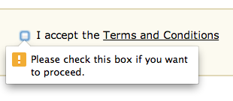
Collecting Sensitive Data
Terms & Conditions
App/website permissions
Devices
Shared resources
Cloud storage

Slide 7
Data Privacy

Slide 8
What is Data Privacy?

Slide 9
Strict securing of sensitive data

Slide 10
Strict securing of sensitive data
Use of data ⇔ Protection of user’s identifiable information

Slide 11
Data Privacy in a ML/DL Context

Slide 12
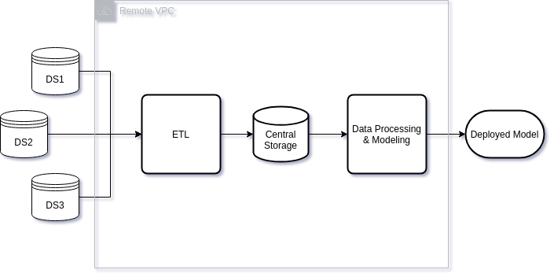
Notes:
Explicar brevemente cada etapa
Data processing: de esto nos ocupamos muchos en Python
Principales issues? Datos van a instancias de terceros, hay canales de envío que pueden ser intervenidos, regulaciones legales de protección de datos.

Slide 13
Notes:
Explicar brevemente cada etapa
Data processing: de esto nos ocupamos muchos en Python
Principales issues? Datos van a instancias de terceros, hay canales de envío que pueden ser intervenidos, regulaciones legales de protección de datos.

Slide 14
Notes:
Explicar brevemente cada etapa
Data processing: de esto nos ocupamos muchos en Python
Principales issues? Datos van a instancias de terceros, hay canales de envío que pueden ser intervenidos, regulaciones legales de protección de datos.

Slide 15
Anything that can be learned about an individual from a statistical database, can be learned without access to it

Slide 16
Anything that can be learned about an individual from a statistical database, can be learned without access to it
Privacy is preserved if, after analysis, the analyzer doesn’t know anything about the individuals in the dataset

Slide 17
Common Privacy Issues

Slide 18
Overexposed Data
Explicit Data
Centralized Data
Notes:
Overexposed: tema de accesos a la data
Explicit: legibilidad de la data
Centralized: single point of leakage

Slide 19

How to handle them?

Slide 20
Overexposed Data Differential Privacy
Explicit Data
Centralized Data

Slide 21
Overexposed Data Differential Privacy
Explicit Data Cryptography
Centralized Data

Slide 22
Overexposed Data Differential Privacy
Explicit Data Cryptography
Centralized Data Federated Learning

Slide 23
Federated Learning

Slide 24
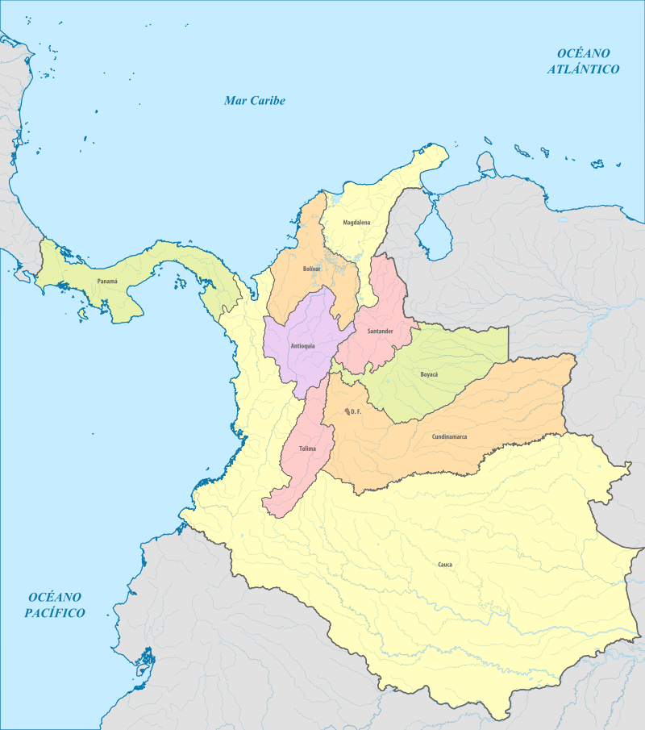
Notes:
Estados unidos de Colombia (1868-1886, acabados por Nuñez) para definir “confederado”. Cada una era independiente en decisiones como votación o elección de funcionarios públicos, pero se acoplanban en un gobierno central con las 3 ramas.

Slide 25
What is Federated Learning?

Slide 26
Same algorithms that centralized ML/DL
Multiple local datasets contained in local nodes
NO exchange of data samples, only parameters!

Slide 27
Centralized Approach

Slide 28


Slide 29
x
x
x

Slide 30


Slide 31
Federated Approach

Slide 33
Θ
Θ
Θ

Slide 34
Θ
Θ
Θ

Slide 35
Θ
Θ
Notes:
Mencionar agregaciones/promedios de los pesos o modelos

Slide 36
Federated
Distributed
Multi-Party
Centralized data
(Un)even data
Centralized data
i.i.d data
Centralized ownership
(un)even data
Function anonymously computed among nodes

Slide 37
Securing Federated Learning
Notes:
Porque igual se transmiten pesos de modelos a los que se les puede hacer reverse engineering

Slide 38
Trusted Aggregators: neutral 3rd-party machines. Don’t look at the gradients when performing aggregations.
Additive Secret Sharing: crypto technique that allows multiple individuals to perform joint aggregation without crossing info.
Fixed Precision Encoding: base codification to handle floating-point arithmetic aggregation.
Notes:
trusted aggregators: PyGrid

Slide 39
Federated Learning In Real Life

Slide 40
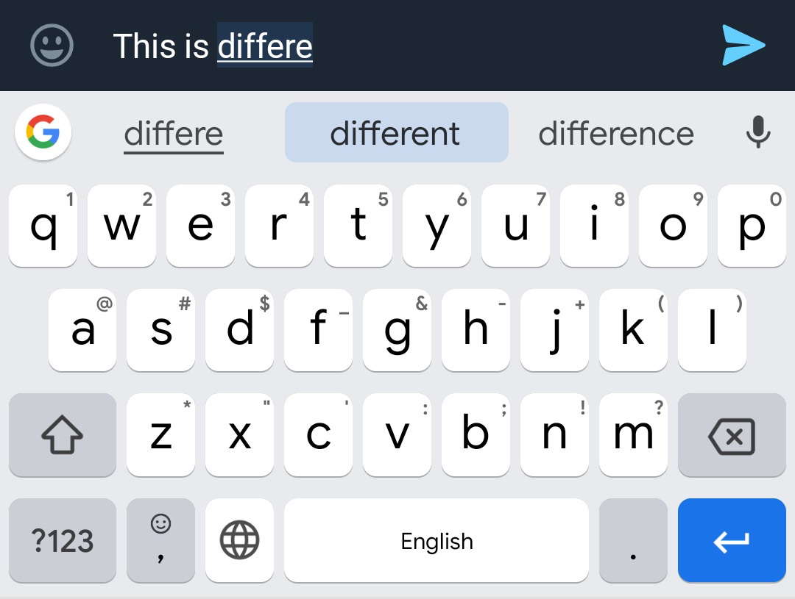
Mobile keyboard auto-completion (Google)

Slide 41
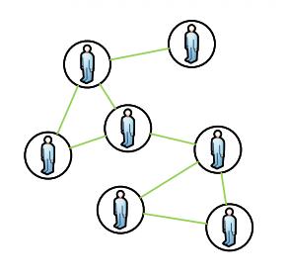
Graph-theoretic analysis of opinion dynamics (MIT)

Slide 42
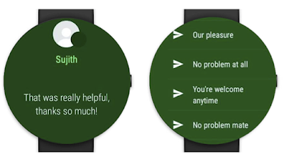
On-device smart reply (Google)

Slide 43
FL in Python

Slide 44




Slide 45
TensorFlow Federated
TensorFlow as back-end
High-level: models, builders, datasets
Low-level: Federated Core API (types, language extension)
Distributed graphs
Supports eager - n.e. mode
Notes:
Laws: poner ejemplo de Uruguay con GCP, data clínica en Alemania

Slide 46
FATE
Webank’s internal dev
High-level, pre-defined functionalities
Stand-alone | cluster modes
Support for HME and MPC
Notes:
Laws: poner ejemplo de Uruguay con GCP, data clínica en Alemania

Slide 47
PySyft
TensorFlow | Keras | Pytorch as available back-ends
Covers remote, encrypted computations and DP.
Compatible with PyGrid (secure nodes)
Notes:
Laws: poner ejemplo de Uruguay con GCP, data clínica en Alemania

Slide 48
Demo

Slide 49
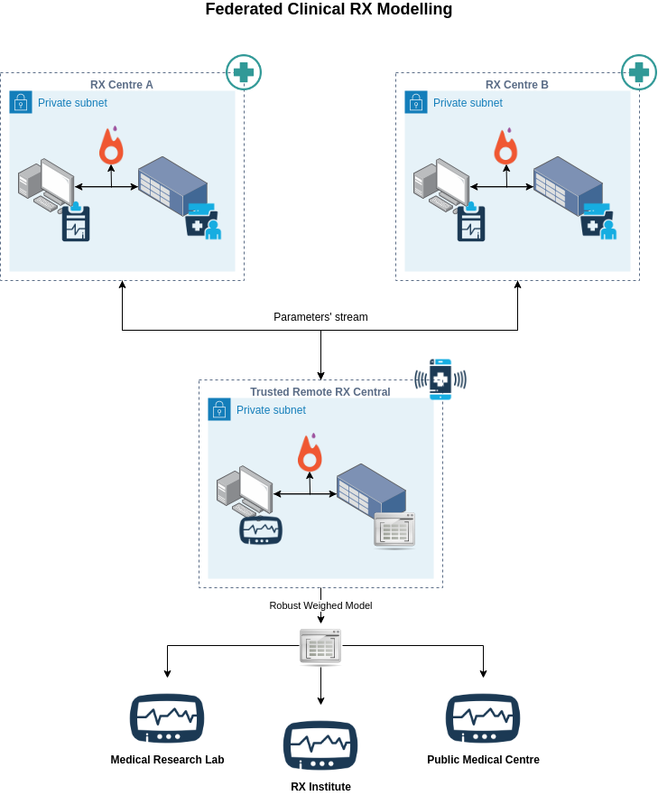

Slide 50
Questions?

Slide 51
Thank You!

